Slide 1
MongoDB
NoSQL Introduction with MongoDB
COMP306: Database Management Systems

Slide 2
Installation
Follow the official guide (You can choose between Windows, Linux, Mac):
https://www.mongodb.com/docs/manual/installation/
Follow the same guide to setup the MongoDB locally, then start it.
You should be able connect to the MongoDB instance and start a command line using mongo.
IMPORTANT: Don’t forget to install MongoDB Compass.
Also install mongosh using following instructions:
https://www.mongodb.com/docs/mongodb-shell/install/#std-label-mdb-shell-install

Slide 3
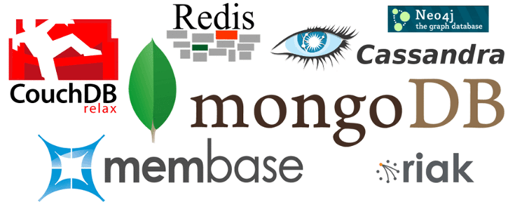
NoSQL
“Big data” fueled the need for highly scalable and available DBMSs
Store data in an organized way, but do not use rows and columns
“Schema-less” or “schema not important”
Support for newly emerging data types (graph data, document data, etc.)
Custom APIs and/or query languages to support new data types

Slide 4
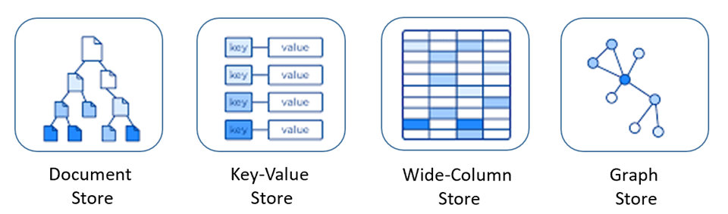
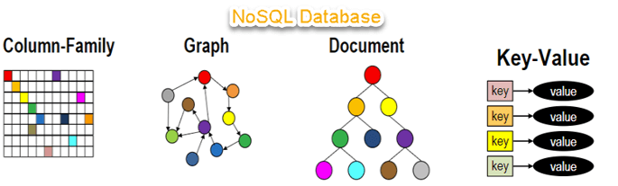
NoSQL Types

Slide 5
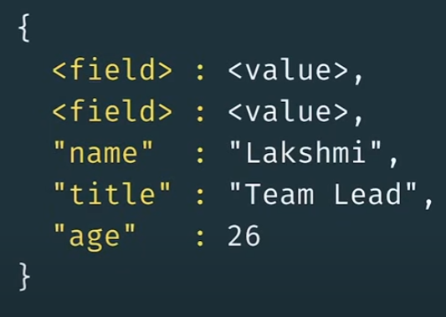
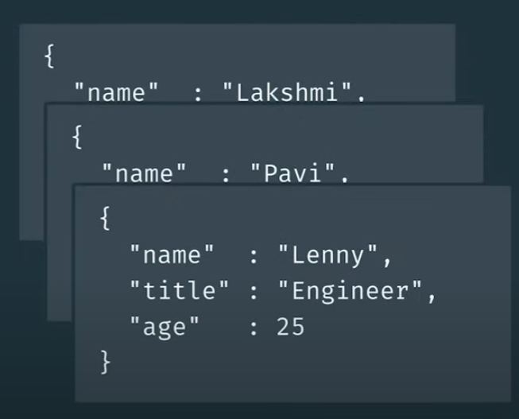
MongoDB
A NoSQL document database.
Stores data in documents
Field-value pairs
Documents are stored in collections.
Documents in a collection share common fields:

Slide 6
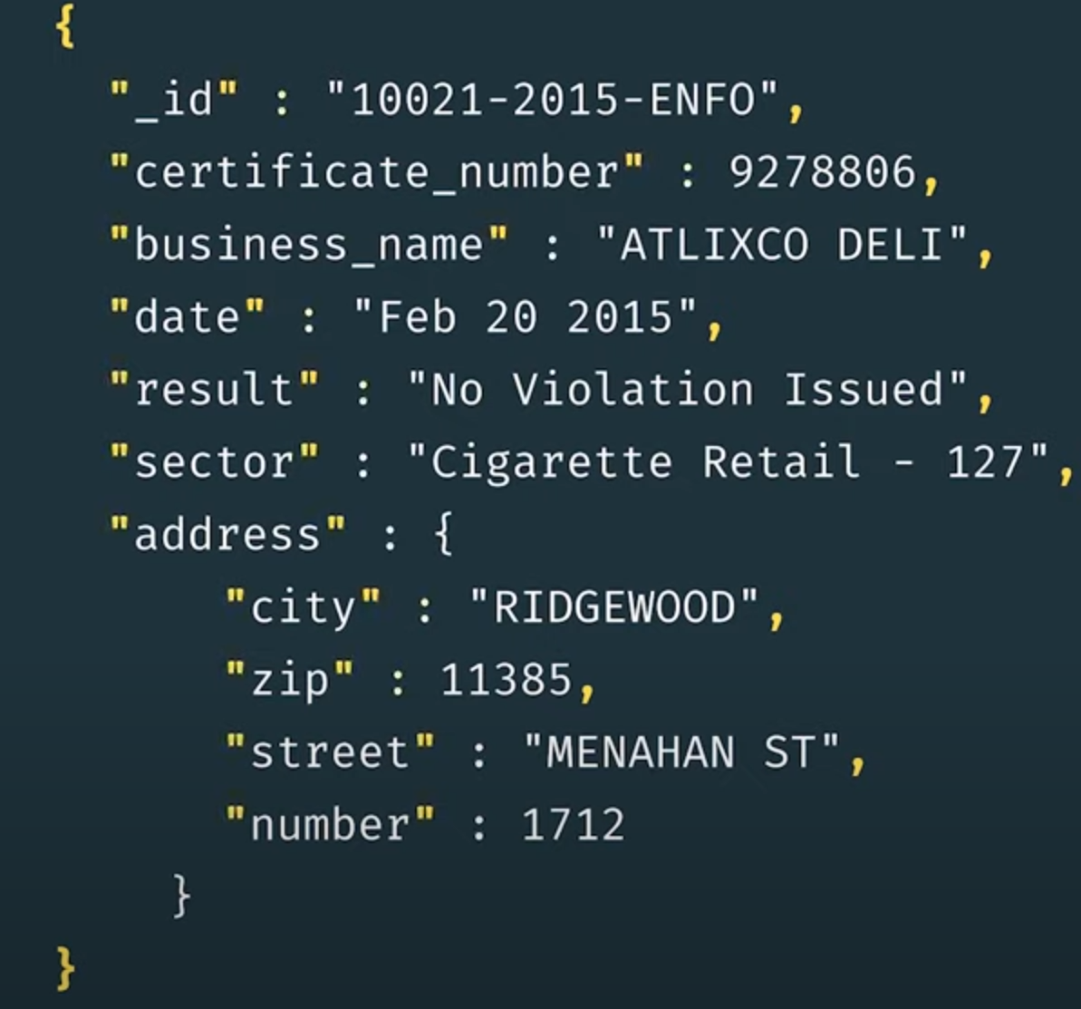
Document Syntax
Bson: Json with binary encoding with additional data type support
Documents start and end with “{ }”
Separate key and value with “:”
Separate each key:value pair with “,”
Values can be of various types, including strings, numbers, booleans, arrays, sub-documents(nested documents), and other BSON data types.

Slide 7
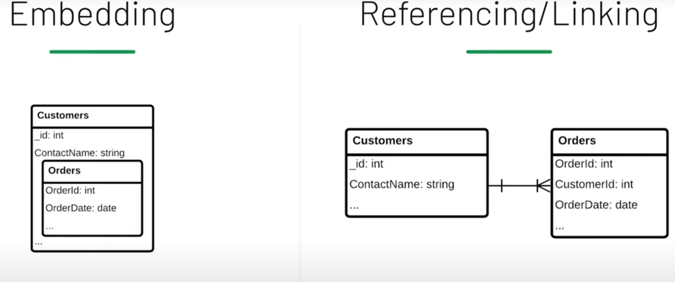
Modeling Documents
Identify Relationships
Decide on parent-child relationships (Embedding vs Referencing):
Embedding requires no foreign keys and it includes an implicit cascading delete.
For one-to-many relationships, arrays can be used.

Slide 8
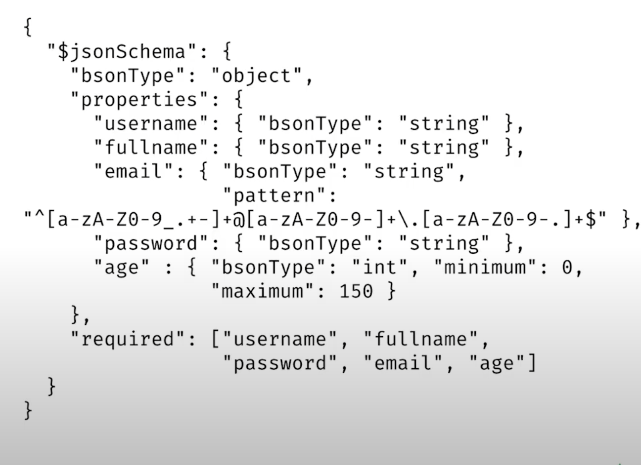
Json Schema
Define data types
Define required fields
Define required values

Slide 9
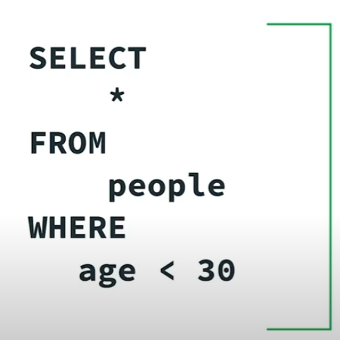
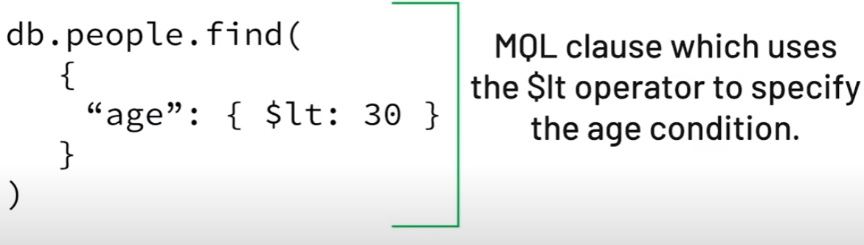
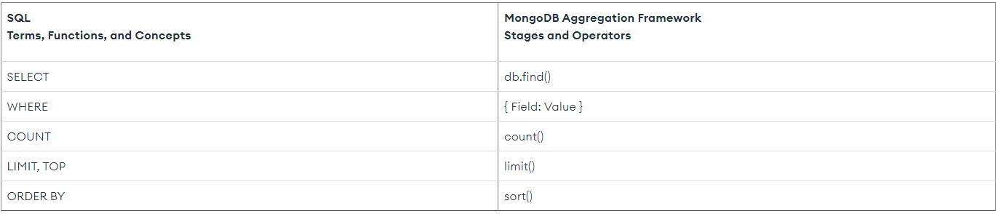
Queries in MongoDB Aggregation Framework
SQL vs MQL:

Slide 10
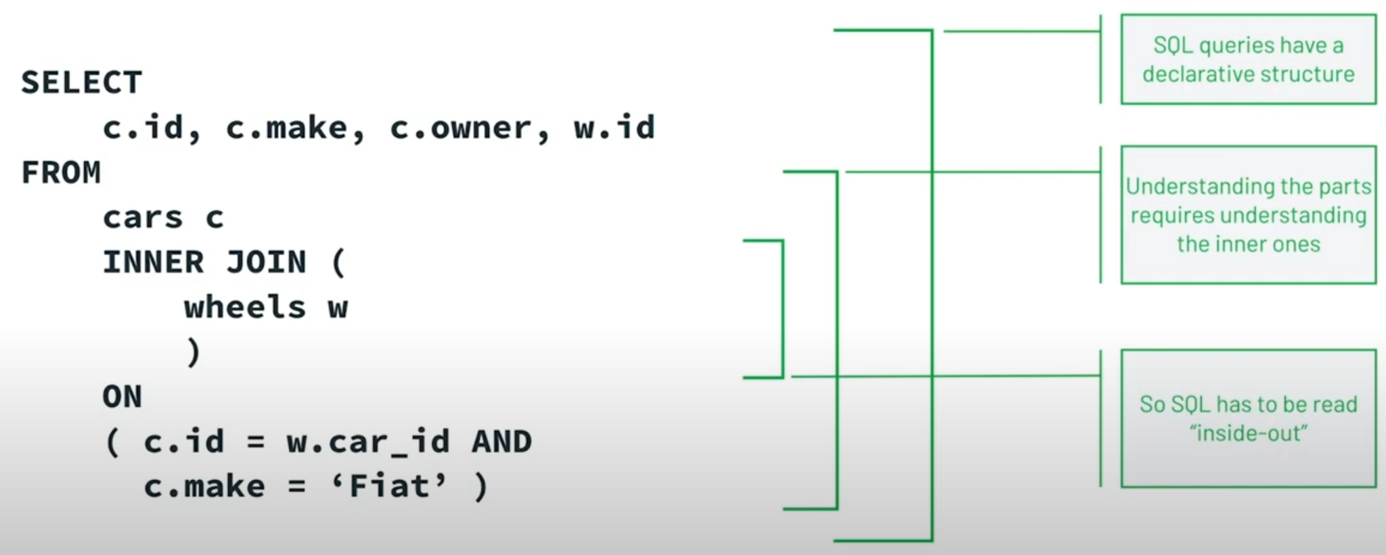
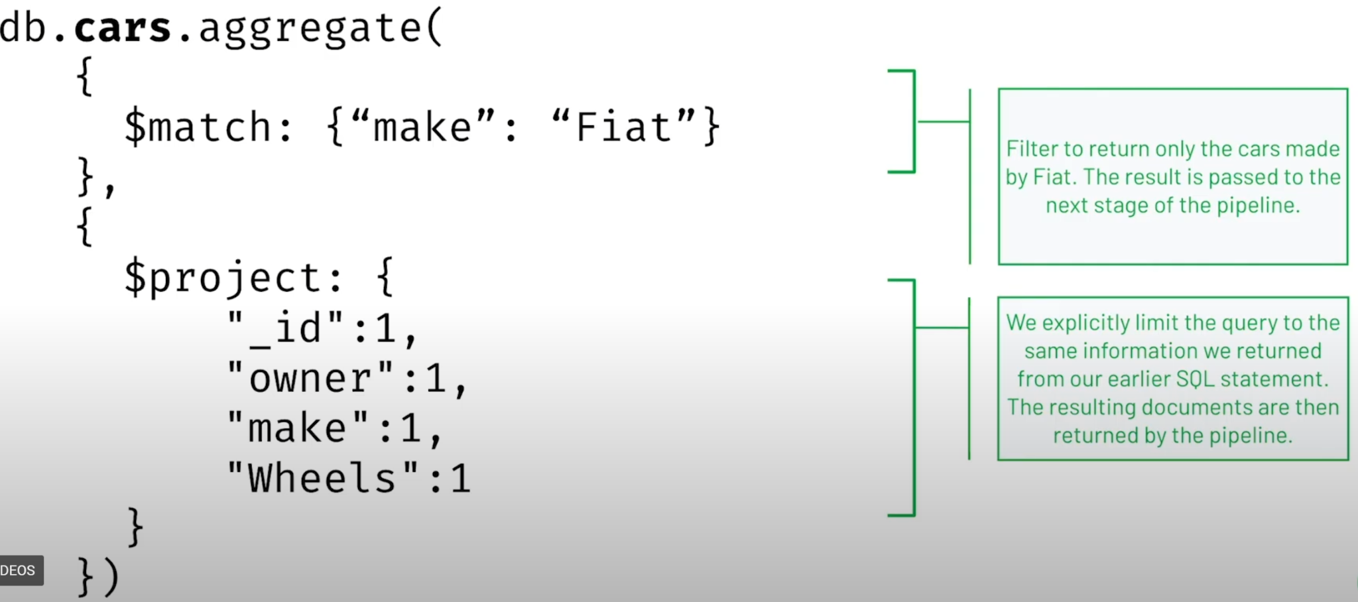
SQL vs MQL

Slide 11
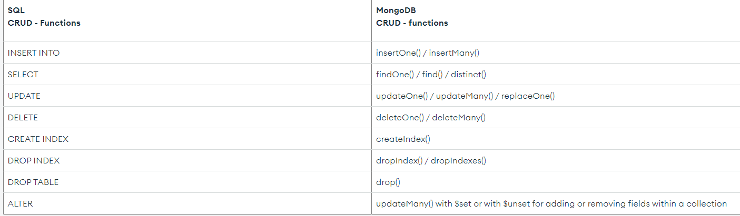
SQL vs MongoDB

Slide 12
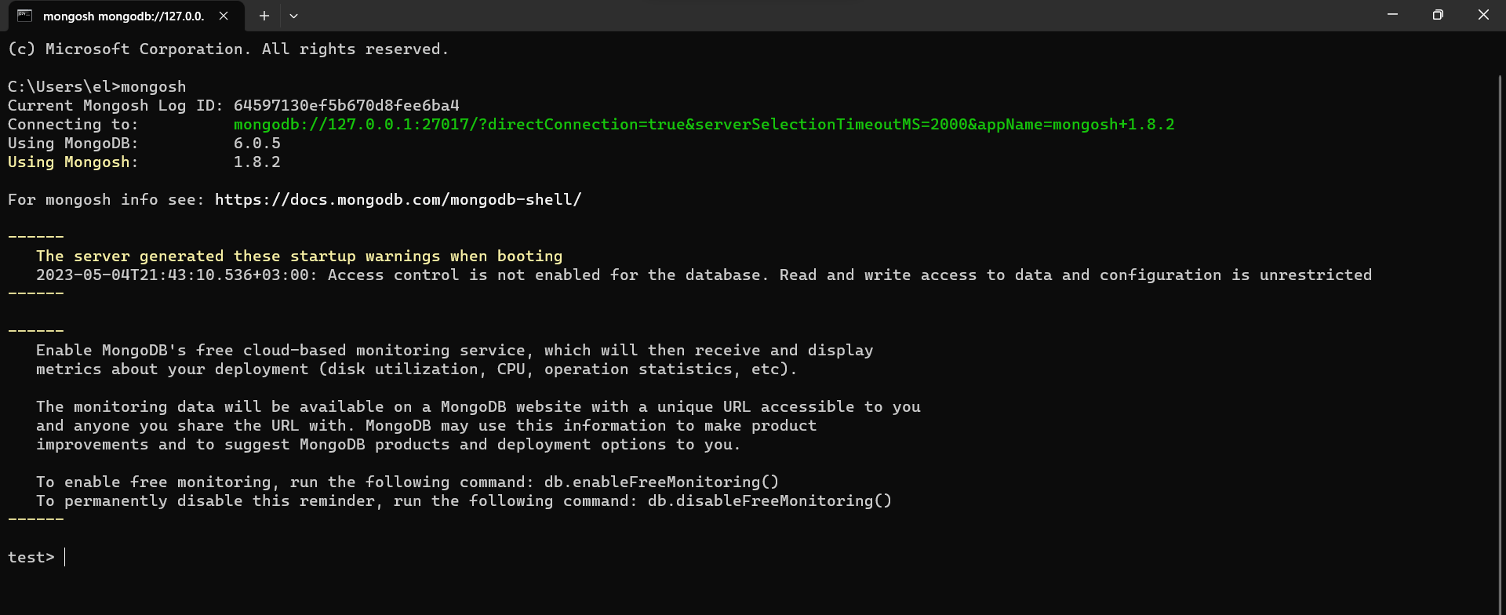
Connecting to MongoDB Instance
Open cmd and type mongosh:
You should see the command line and start to enter queries

Slide 13
Authentication
By default, anyone can access your MongoDB server.
Set up super user authentication using this guide:
https://www.shellhacks.com/mongodb-create-user-database-admin-root/
When creating the superuser, change the “pwd” field with your choice of password.

Slide 14
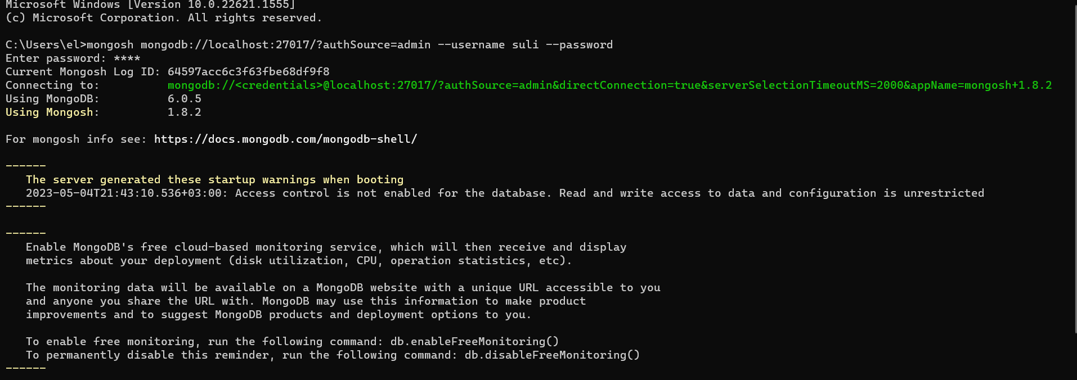
Authentication
You can connect to MongoDB with your credentials as follows:

Slide 15

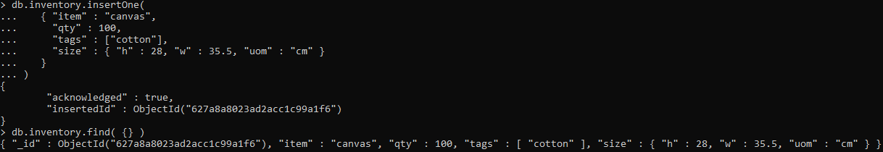
Insert a Document
To select a database:
Insert a document and display all documents in the db:
When we open another document inside using “{ }”, this is called sub-document.
“inventory” is the collection here, db refers to the selected db.
As seen above, a primary key (unique id) is automatically created.

Slide 16
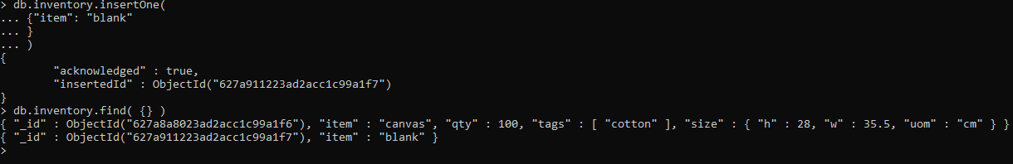
Schema-less Design?
Unlike SQL tables, MongoDB collections have dynamic schemas.
That is, a single collection can store documents that differ in shapes (i.e., contain different fields and value types).

Slide 17
Schema-less Design?
Thus, we don’t need to define a schema, but we can define constraints:

Slide 18
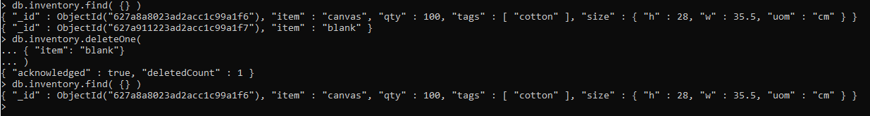
Deleting a Document
To match a document indicate a field-value pair.

Slide 19
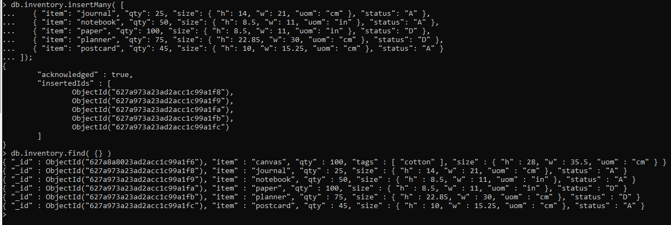
Batch Insert
Inserting documents in batches: (https://www.mongodb.com/docs/guides/server/read_queries/)

Slide 20
Filtering with Queries
Collection.find() is used to filter the collection according to key-value pair inside the brackets.

Slide 21
Compound Queries
Select documents with height less than 15:
Implicit “and” queries: (Documents with status “A” and qty less than 30)
“or” queries: (Documents with status “A” and qty less than 30 or item matching this regex)

Slide 22
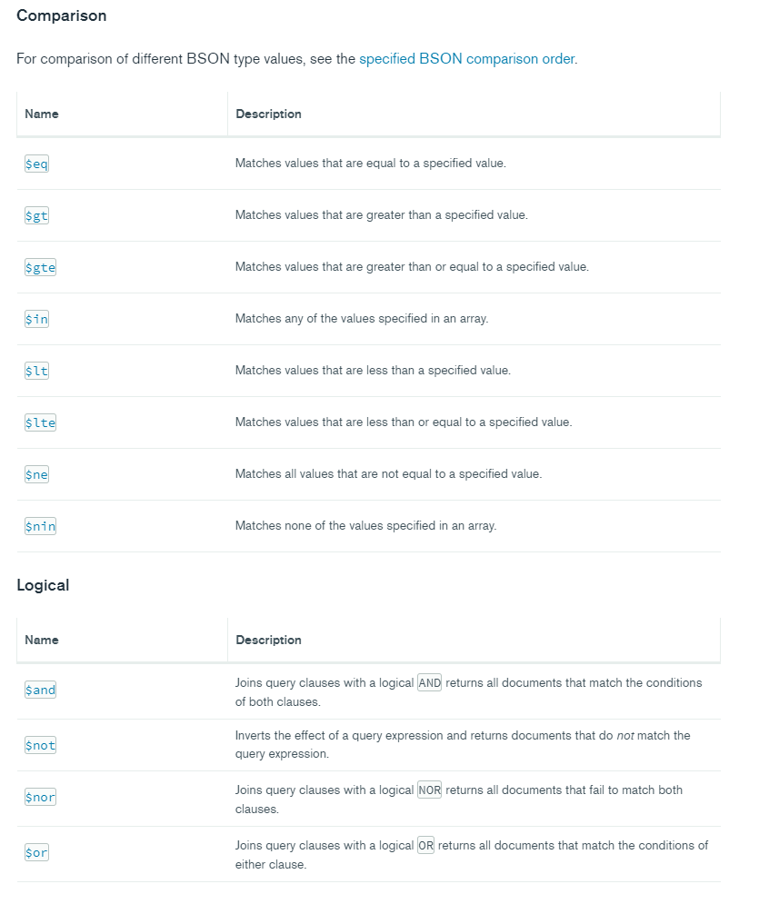
Query Selectors

Slide 23
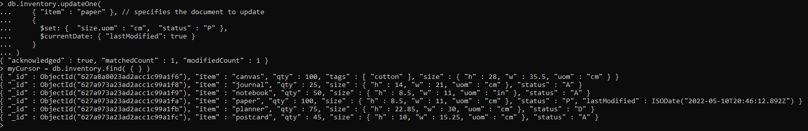
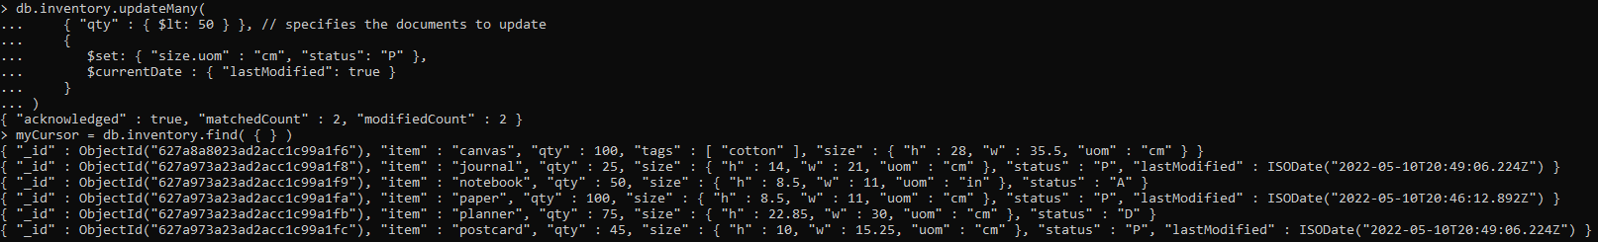
Update Queries
Update one document:
Update multiple documents:

Slide 24

Importing Collections
mongoimport tool is included with the database tools package. Download and install it: https://www.mongodb.com/docs/database-tools/installation/installation/
Use mongoimport tool to import the given zips.json collection file to a collection called zipcodes:

Slide 25
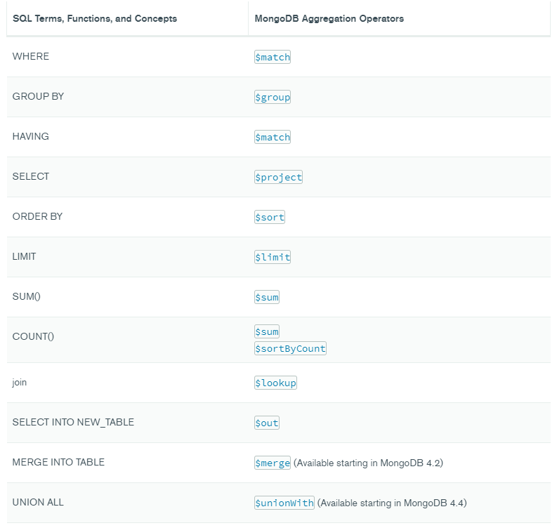
Aggregation Operators SQL vs MongoDB

Slide 26
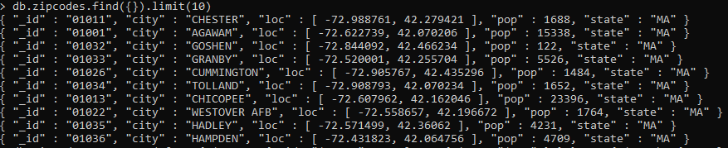
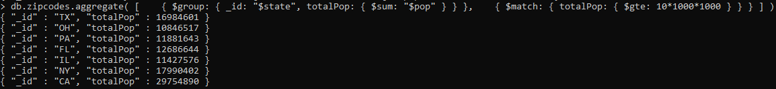
Aggregation Queries
Get first 10 documents using limit:
Return States with Populations above 10 Million:
$group is equivalent to GROUP BY in SQL.__id: field must be used to indicate grouping field. $match is similar to HAVING in SQL.

Slide 27
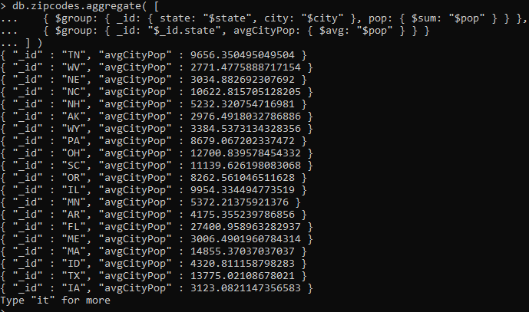
Aggregation Queries
Return Average City Population by State
The first $group stage groups the documents by the combination of city and state, calculates the population for each combination, and outputs a document for each city and state combination. Second $group state calculates averages for each state coming from the first group stage.

Slide 28

Preparation
db.orders.insertMany( [
{ "_id" : 1, "item" : "almonds", "price" : 12, "quantity" : 2 },
{ "_id" : 2, "item" : "pecans", "price" : 20, "quantity" : 1 },
{ "_id" : 3 }
] )
db.inventory.insertMany( [
{ "_id" : 1, "sku" : "almonds", "description": "product 1", "instock" : 120 },
{ "_id" : 2, "sku" : "bread", "description": "product 2", "instock" : 80 },
{ "_id" : 3, "sku" : "cashews", "description": "product 3", "instock" : 60 },
{ "_id" : 4, "sku" : "pecans", "description": "product 4", "instock" : 70 },
{ "_id" : 5, "sku": null, "description": "Incomplete" },
{ "_id" : 6 }
] )

Slide 29
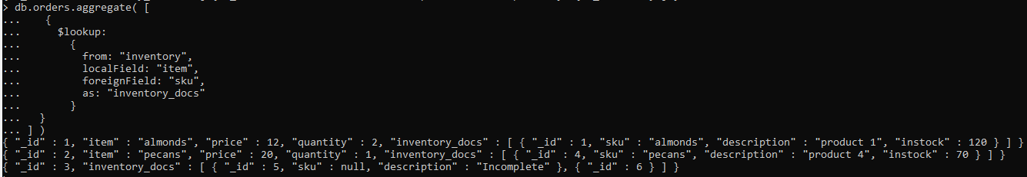
Joins
This aggregation operation on the orders collection joins the documents from orders with the documents from the inventory collection, using the item field from the orders collection and the sku field from the inventory collection. It saves the join in the inventory_docs field.

Slide 30
Schema Validation
db.createCollection("students", {
validator: {
$jsonSchema: {
bsonType: "object",
required: [ "name", "year", "major", "address" ],
properties: {
name: {
bsonType: "string",
description: "must be a string and is required"
},
year: {
bsonType: "int",
minimum: 2017,
maximum: 3017,
description: "must be an integer in [ 2017, 3017 ] and is required"
},
major: {
enum: [ "Math", "English", "Computer Science", "History", null ],
description: "can only be one of the enum values and is required"
},
gpa: {
bsonType: [ "double" ],
description: "must be a double if the field exists"
},
address: {
bsonType: "object",
required: [ "city" ],
properties: {
street: {
bsonType: "string",
description: "must be a string if the field exists"
},
city: {
bsonType: "string",
description: "must be a string and is required"
}
}
}
}
}
}
})

Slide 31
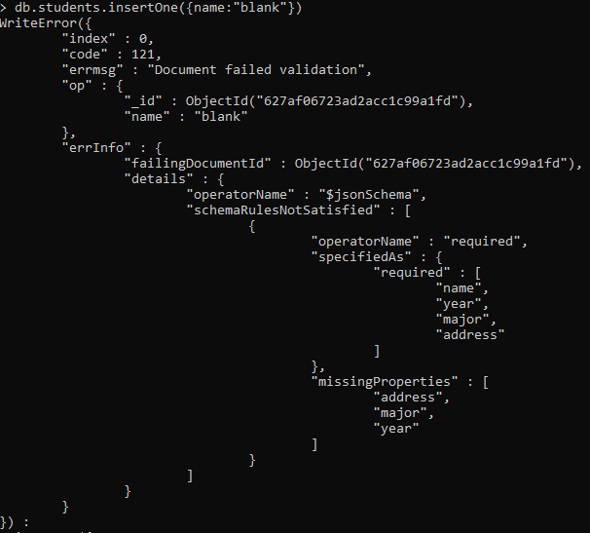
Schema Validation
Note: MongoDB considers all numbers as float type, convert to int using NumberInt()

Slide 32
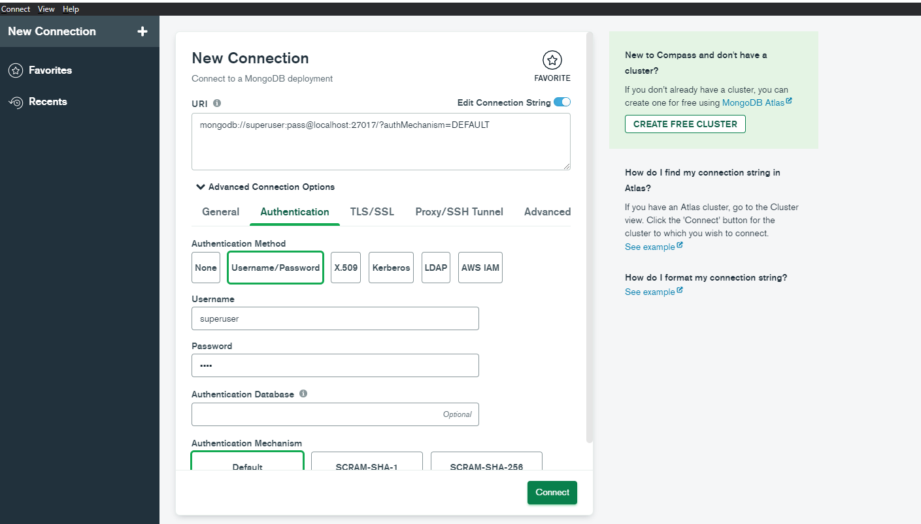
MongoDB Compass GUI
Enter the URI using your username and password

Slide 33
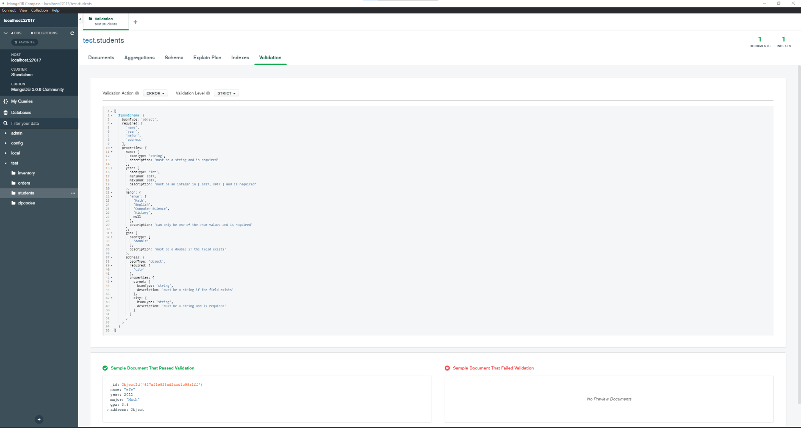
MongoDB Compass GUI
Check documents in collections, check schema validations.

Slide 34
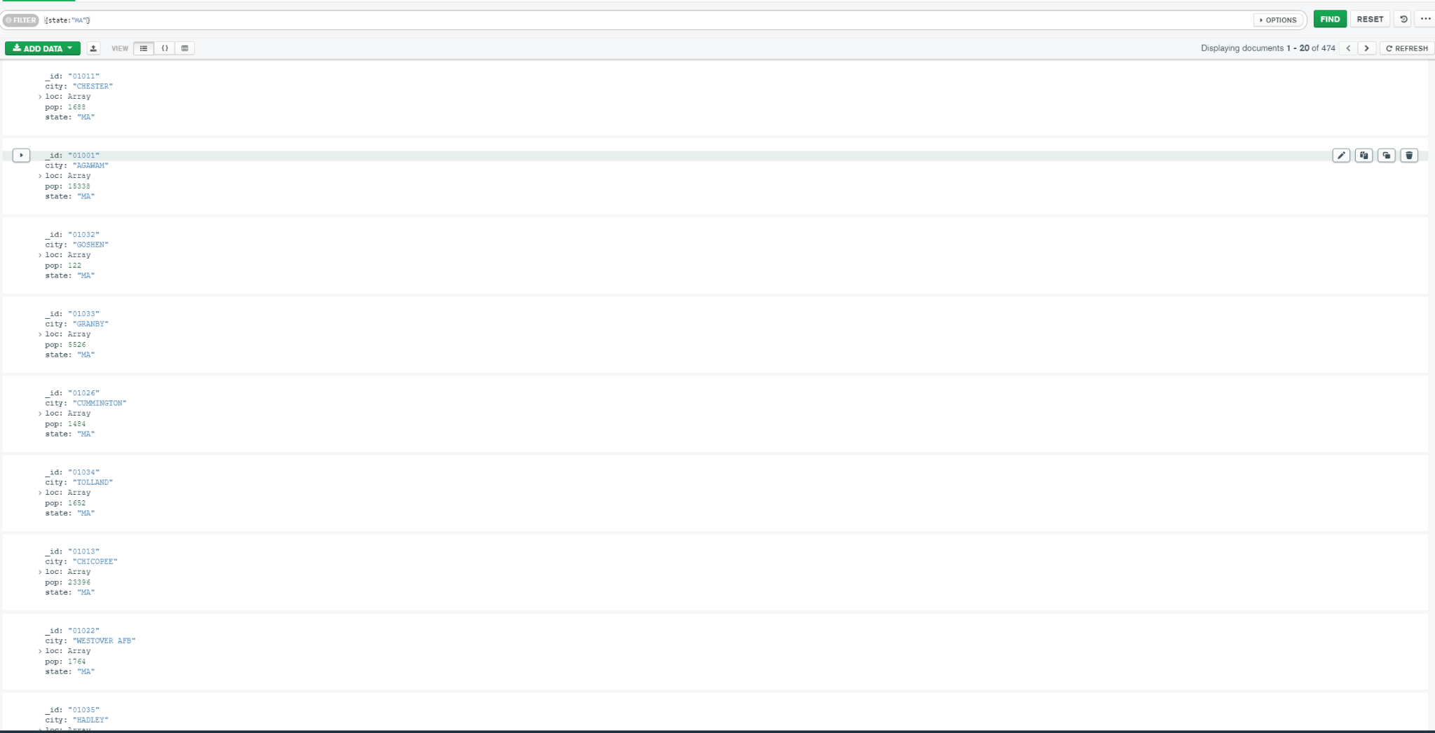
MongoDB Compass GUI
Use queries without using MongoDB commands such as find()

